Slide 1
Hidden Markov Model
B4
Shoma Takamatsu, Shogo Mori, Hiroki Irie, Atsushi Fujimoto, Haruka Motoda,
Yuuki Murokawa, Hiroki Naka, Kuniyuki Funasaka

Slide 2
HMM(Hidden-Markov-Model)
In each state of the Markov process, a model considering stochastic symbol output.
Handle time series data
Probabilistic model in which future behavior is determined only by current value
＝Stochastic process
using Markov characteristic

Slide 3
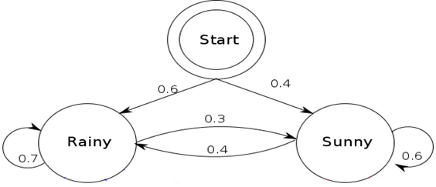
Markov Model
Conditional probability
P(x|y)
Probability of occurrence of x when event y occurs
State：｛Rainy, Sunny｝
Transition probability：
P(‘Rainy’|’Rainy’) =0.7, P(‘Sunny’|’Rainy’) =0.3 ,
P(‘Rainy’|’Sunny’) =0.4, P(‘Sunny’|’Sunny’) =0.6
Initial probability： P(‘Rainy’)=0.6, P(‘Sunny’)=0.4

Slide 4
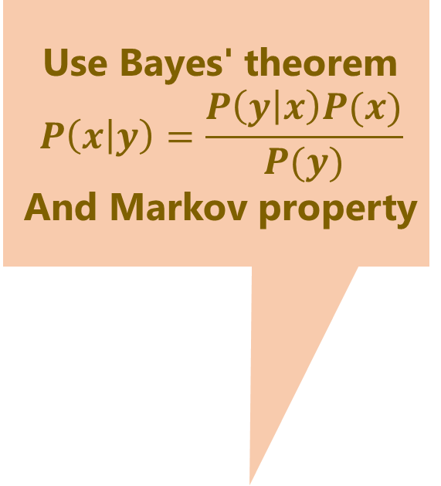
Markov Model
Use Bayes' theorem
$$P\left(x | y\right)=\frac{P\left(y | x\right)P(x)}{P(y)}$$ And Markov property
ex) Probability of state column of｛’Sunny’, ’Sunny’, ’Rainy’, ‘Rainy’｝
P(｛’Sunny’, ’Sunny’, ’Rainy’, ‘Rainy’｝)=
P(‘Rainy’|’Rainy’)P(‘Rainy’|’Sunny’)P(‘Sunny’|’Sunny’)P(‘Sunny’)=
0.7*0.4*0.6*0.4=0.0672

Slide 5
HMM(Hidden-Markov-Model)
In each state of the Markov process, a model considering stochastic symbol output
？
Each state can not be observed, but data outputted from the state can be measured

Slide 6
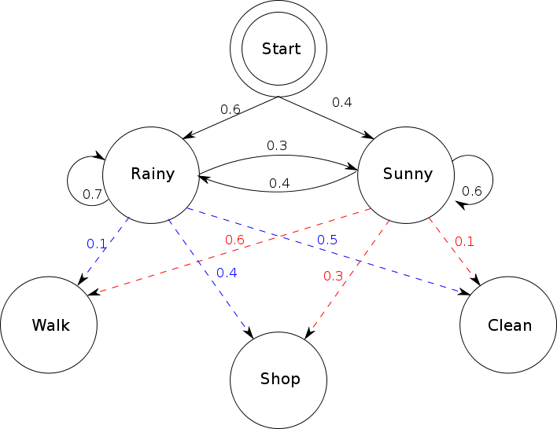
HMM
Hidden state
Output symbol
Output (observation) probability
P(‘Rainy’|’Walk’), P(‘Rainy’|’Shop’), P(‘Rainy’|’Clean’),
P(‘Sunny’|’Walk’), P(‘Sunny’|’Shop’), P(‘Sunny’|’Clean’)

Slide 7

To the real world ...
Output (observation) probability
{‘Walk’,
‘Shop’,
‘Clean’}
Hidden State
{‘Sunny’,
‘Rainy’}
Bob
Act only by the weather
ボブ

Slide 8
HMM・ Value definition
Initial state probability
Hidden state
Output symbol

Slide 9
HMM・ Value definition
State transition probability
Hidden state
Output symbol

Slide 10
HMM・ Value definition
Output (observation) probability
Hidden state
Output symbol

Slide 11

HMM・ Value definition
State set Q, Output Symbol set Σ
$Q=\{q_{1},・・・q_{N}\}$
$Σ=\{o_{1},・・・O_{M}\}$
Each parameter (probability distribution)
Initial state probability distribution$π=\{π_{i}\}$
State transition probability distribution $A=\{a_{ij}\}$
Symbol output probability distribution $B=\{b_{i}(o_{t})\}$

Slide 12
HMM・ Value definition
State set Q, Output Symbol set Σ
$Q=\{q_{1},・・・q_{N}\}$
$Σ=\{o_{1},・・・O_{M}\}$
Each parameter (probability distribution)
Initial state probability distribution$π=\{π_{i}\}$
State transition probability distribution $A=\{a_{ij}\}$
Symbol output probability distribution $B=\{b_{i}(o_{t})\}$

Slide 13
HMM・ Value definition
State set Q, Output Symbol set Σ
$Q=\{q_{1},・・・q_{N}\}$
$Σ=\{o_{1},・・・O_{M}\}$
Each parameter (probability distribution)
Initial state probability distribution$π=\{π_{i}\}$
State transition probability distribution $A=\{a_{ij}\}$
Symbol output probability distribution $B=\{b_{i}(o_{t})\}$

Slide 14
HMM・ Value definition
State set Q, Output Symbol set Σ
$Q=\{q_{1},・・・q_{N}\}$
$Σ=\{o_{1},・・・O_{M}\}$
Each parameter (probability distribution)
Initial state probability distribution$π=\{π_{i}\}$
State transition probability distribution $A=\{a_{ij}\}$
Symbol output probability distribution $B=\{b_{i}(o_{t})\}$

Slide 15
HMM・ Value definition
State set Q, Output Symbol set Σ
$Q=\{q_{1},・・・q_{N}\}$
$Σ=\{o_{1},・・・O_{M}\}$
Each parameter (probability distribution)
Initial state probability distribution$π=\{π_{i}\}$
State transition probability distribution $A=\{a_{ij}\}$
Symbol output probability distribution $B=\{b_{i}(o_{t})\}$

Slide 16
HMM(Hidden Markov Model)
Problems to be handled
Evaluation problem
Find the probability (likelihood) that the observation sequence is obtained from the model
Decoding problem
Estimate maximum likelihood state transition sequence from observation sequence
Estimation problem
Estimate the parameters of the model

Slide 17
HMM
Evaluation problem
A problem of finding the probability P (O | M) (likelihood) that the observation sequence O was generated from the model M when the observation sequence O and the model M are given
There is a high probability that the observation series of 'clean' will be generated from HMM with parameters that 'rain' tends to fall.
Likelihood
Model identification

Slide 18
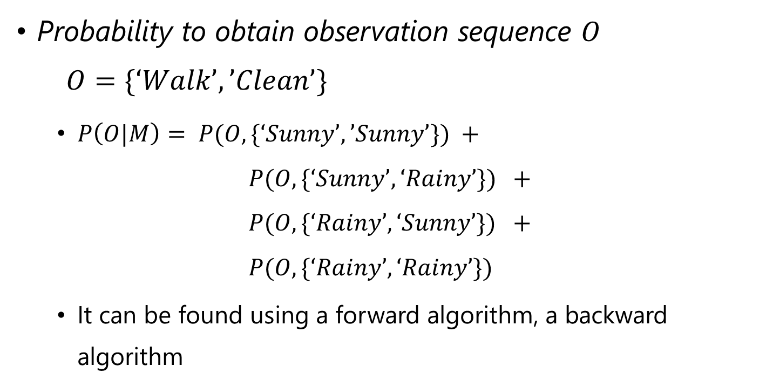
Evaluation problem
Probability to obtain observation sequence $O$ $O=\{‘Walk’, ’Clean’\}$
$P\left(O|M\right)= P(O, \{‘Sunny’, ’Sunny’\}) +$ $P(O, \{‘Sunny’, ‘Rainy’\}) +$ $P(O, \{‘Rainy’, ‘Sunny’\}) +$ $P(O, \{‘Rainy’, ‘Rainy’\})$
It can be found using a forward algorithm, a backward algorithm

Slide 19
HMM
Decoding problem
A problem of finding the optimal state transition series of the model M that generated the observation sequence O when the observation sequence O
and the model M are given
Viterbi algorithm

Slide 20
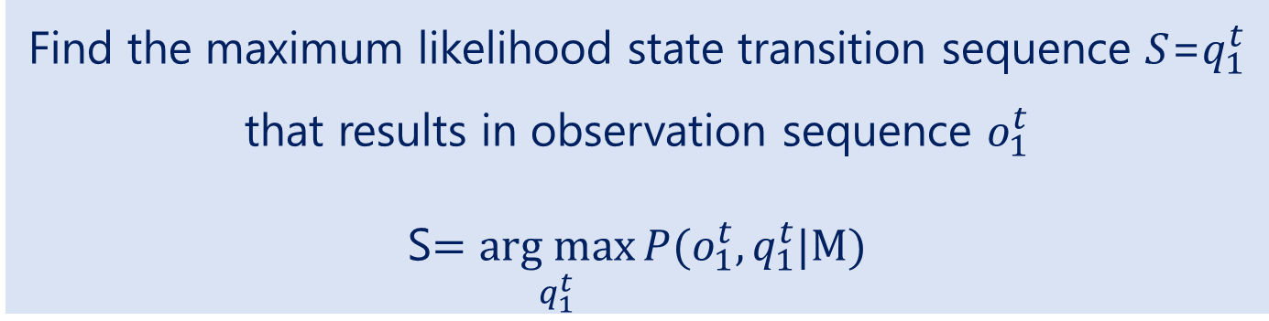
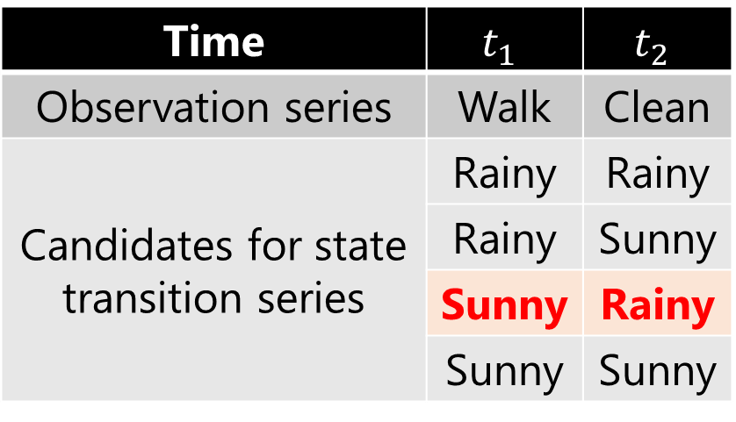
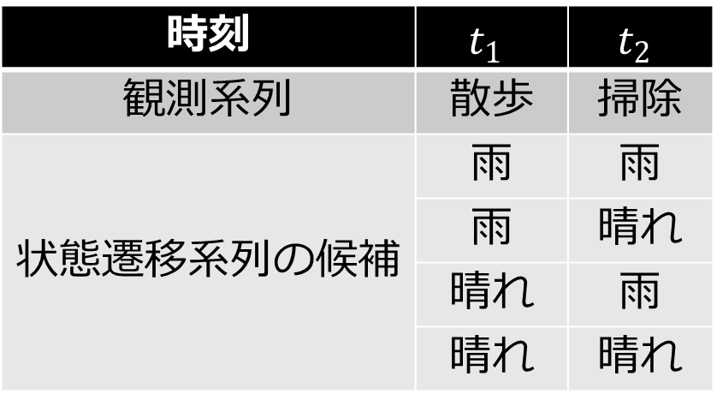
Decoding
時刻 | $$t_{1}$$ | $$t_{2}$$
観測系列 | 散歩 | 掃除
状態遷移系列の候補 | 雨 | 雨
 | 雨 | 晴れ
 | 晴れ | 雨
 | 晴れ | 晴れ
Time | $$t_{1}$$ | $$t_{2}$$
Observation series | Walk | Clean
Candidates for state transition series | Rainy | Rainy
 | Rainy | Sunny
 | Sunny | Rainy
 | Sunny | Sunny
Find the maximum likelihood state transition sequence $S$=$q_{1}^{t}$ that results in observation sequence $o_{1}^{t}$ S$=\underset{q_{1}^{t}}{arg max}{P(o_{1}^{t},q_{1}^{t}|M)}$

Slide 21

Example
Alice (observer)
Weather trend (parameter) grasp
Guess weather from Bob's behavior
Bob's behavior
Decide action only by the weather
Tell Alice only behavior
Alice
Bob

Slide 22





Example
State series
Weather around Bob
Observation sequence Bob’s behavior

Slide 23
Example
I predict the weather
・・・
Alice
Bob

Slide 24
Example
What were you doing three days ago?
Walk
Alice
Bob

Slide 25
Example
Two days ago?
Walk
Alice
Bob

Slide 26
Example
Yesterday?
Clean
Alice
Bob

Slide 27

Example
Clean
Weather is
sunny, sunny, rainy!
Correct!
Alice
Bob

Slide 28
Example
Clean
Weather is
sunny, sunny, rainy!
Correct!
Alice
Bob
Observation sequence | Walk | Walk | Clean
the max likelihood state transition sequence | Sunny | Sunny | Rainy
Actual weather | Sunny | Sunny | Rainy

Slide 29
HMM
Learn parameters from observation sequence
Estimation problem
Problem of finding a model M that maximizes P(O|M) from observation sequence O
Baum Welch algorithm

Slide 30
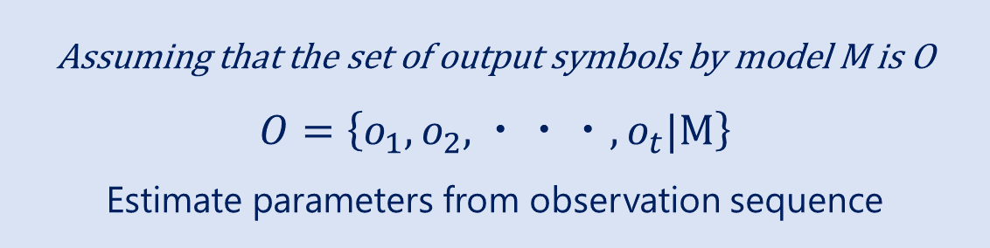
Estimate
Model M
？
？
？
？
？
？
？
？
？
？
？
？
Assuming that the set of output symbols by model M is O
$$O=\left\{o_{1},o_{2},・・・,o_{t}|M\right\}$$
Estimate parameters from observation sequence

Slide 31
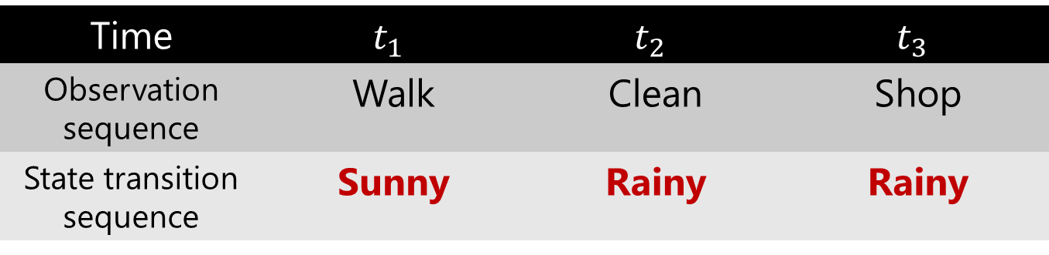
What can we do with HMM after all?
Decoding problem
Hidden state
Output symbol
Time | $$t_{1}$$ | $$t_{2}$$ | $$t_{3}$$
Observation sequence | Walk | Clean | Shop
State transition sequence | Sunny | Rainy | Rainy
obtained by decoding

Slide 32
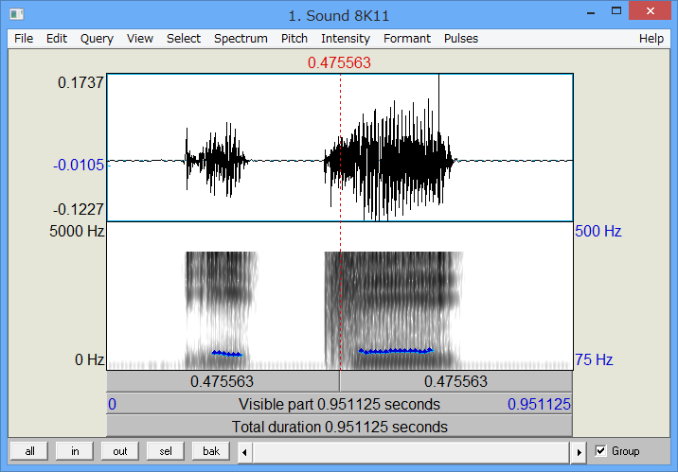





What can we do with HMM after all?
Decoding problem
Chord recognition： Perform chord recognition from music audio signal
State transition: transitions between chords
Observation sequence: acoustic signal sequence
$$q_{1}$$
$$q_{n}$$
$$o_{1}$$
$$o_{m}$$
...

Slide 33
What can we do with HMM after all?
Estimation problem
？
？
？
？
？
？
？
？
？
？
？
？
Learning
Observation sequence１ | Walk | ... | Shop
Observation sequence２ | Clean | ... | Shop
…
Observation sequence N | Shop | ... | Clean

Slide 34
What can we do with HMM after all?
Estimation problem
Can be used for model learning with observation sequence only
？
？
？
？
？
？
？
？
？
？
？
？

Slide 35
Summary
What is HMM?
In each state of the Markov process, a model considering stochastic symbol output
Three problems
Evaluation problem
Find the likelihood of observation sequence
Decoding problem
Find the maximum likelihood state transition sequence
Estimation problem
Estimate parameters of HMM
Hidden state
Output symbol

Slide 36
Practical training
Handle HMM in Python
Calculate each parameter from statistical information
{State transition sequence},{Observation sequence} → Calculate Probability
It inputs the obtained parameter into the program, generates HMM, and outputs sample data
※ PC and the program will be distributed later. I will explain it.

Slide 37
Practical training
Handle HMM in Python
Run the decoding problem and estimation problem programatically based on sample data

Slide 38
References
[1]北研二.確率的言語モデル.東京大学出版会,1999
[2]時系列データ:隠れマルコフモデルの基礎と、リカレントネットの台等.HELLO CYBERNETICS. http://s0sem0y.hatenablog.com/entry/2017/01/14/235811
[3]伊庭斉志.HMM:隠れマルコフモデル(pdf) http://www.iba.t.u-tokyo.ac.jp/~iba/SE/HMM/HMM.pdf
[4]Hidden Markov Model -Wikipedia https://en.wikipedia.org/wiki/Hidden_Markov_model
[5]篠崎隆宏. HMMって僕にも分かりますか？(pdf) 日本音響学会ビギナーズセミナー2013秋
[6]ベイズの定理の基本的な解説.高校数学の美しい物語. https://mathtrain.jp/bayes

Slide 39
References
[7]海野裕也. 形態素解析の過去・現在・未来.PFIセミナー. 2011. https://www.slideshare.net/pfi/ss-9805912
[8]形態素解析-Wikipedia https://ja.wikipedia.org/wiki/%E5%BD%A2%E6%85%8B%E7%B4%A0%E8%A7%A3%E6%9E%90
[9]中沢彰吾.隠れマルコフモデルによる自動和音認識に基づく カバー演奏ストリームからの原曲同定システム. 2013 http://hdl.handle.net/2241/121383

Slide 40
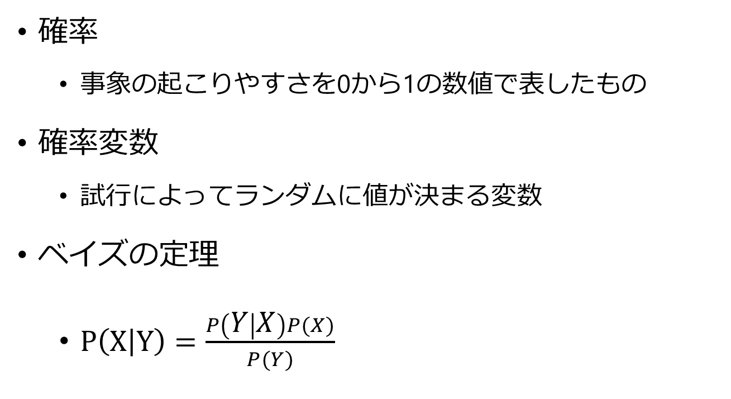
確率の話
確率
事象の起こりやすさを0から1の数値で表したもの
確率変数
試行によってランダムに値が決まる変数
ベイズの定理
$P\left(X | Y\right)=\frac{P\left(Y | X\right)P(X)}{P(Y)}$

Slide 41
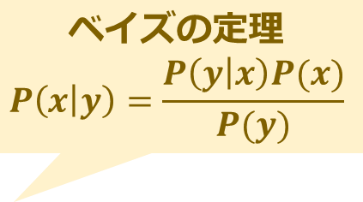
ベイズの定理とマルコフ性
ベイズの定理
「事象x,yが起きる確率」は, 「事象xが起きてから事象yが起きる確率(式１)」と「事象yが起きてから事象xが起きる確率(式２)」の 恒等式として(式３)が得られ,これを変形したもの
p(x,y)=p(y)p(x|y)・・・⑴
p(x,y)=P(x)P(y|x)・・・⑵
⑴、⑵より
p(y)p(x|y)=p(x)p(y|x)⇔
p(x|y)=p(y|x)p(x)/p(y)・・・⑶
ベイズの定理
$$P\left(x | y\right)=\frac{P\left(y | x\right)P(x)}{P(y)}$$

Slide 42
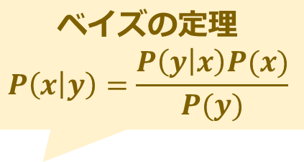
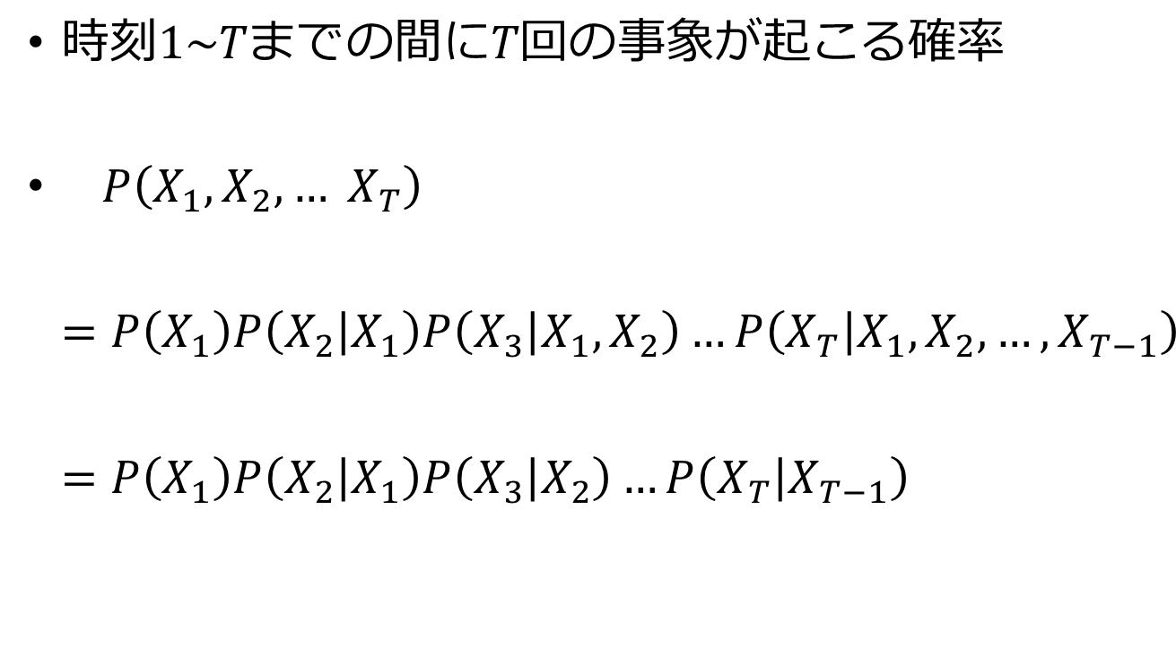
ベイズの定理とマルコフ性
時刻$1\sim Tまで$の間に$T回の$事象が起こる確率
$P\left(X_{1},X_{2},… X_{T}\right)$ $=P\left(X_{1}\right)P\left(X_{2} | X_{1}\right)P\left(X_{3} | X_{1},X_{2}\right)…P\left(X_{T} | X_{1},X_{2},…,X_{T−1}\right)$ $=P\left(X_{1}\right)P\left(X_{2} | X_{1}\right)P\left(X_{3} | X_{2}\right)…P\left(X_{T} | X_{T−1}\right)$
ベイズの定理
$$P\left(x | y\right)=\frac{P\left(y | x\right)P(x)}{P(y)}$$
マルコフ性を適用

Slide 43

用語・パラメータ
用語
隠れ状態の集合$Q={\{q_{1}:}^{′}{Rainy}^{′}{,q_{2}}^{′}Sunny′\}$
観測記号の集合$Σ={\{o_{1}:}^{′}Walk^{′}, o_{2}:^{′}Shop^{′}, o_{3}:′Clean′\}$
パラメータ
初期状態確率分布$π=\{π_{1}:P\left(′Rainy^{′}\right),π_{2}:P(′Sunny′)\}$
状態遷移確率分布$A=\{a_{11}:P\left(′Rainy′|^{′}Rainy′\right),…\}$
記号出力確率分布$B=\left\{b_{1}\left(o_{1}\right):P\left(′Sunny′\right){{|P(}^{′}Walk}^{′}\right),…\}$

Slide 44


結局HMMで何ができるのか？
評価問題
話者の識別
話者A
今日は晴れです
話者B
モデルAの尤度:0.6
モデルBの尤度:0.1
話者はA

Slide 45
結局HMMで何ができるのか？
復号問題
形態素解析：単語分割、品詞推定、語義の推定
うらにわにはにわとりがいる
裏庭 /には/二/羽/トリ/が/いる
裏/に/ワニ/は/鶏/が/いる
裏庭/には/鶏/が/いる
裏庭/に/埴輪/取り/が/いる
うらにわにはにわとりがいる
裏庭 /には/二/羽/トリ/が/いる
裏/に/ワニ/は/鶏/が/いる
裏庭/には/鶏/が/いる
裏庭/に/埴輪/取り/が/いる
$$q_{1}$$
$$q_{n}$$
$$o_{1}$$
$$o_{m}$$
...
例はwikipedia“形態素解析”より引用

Slide 46
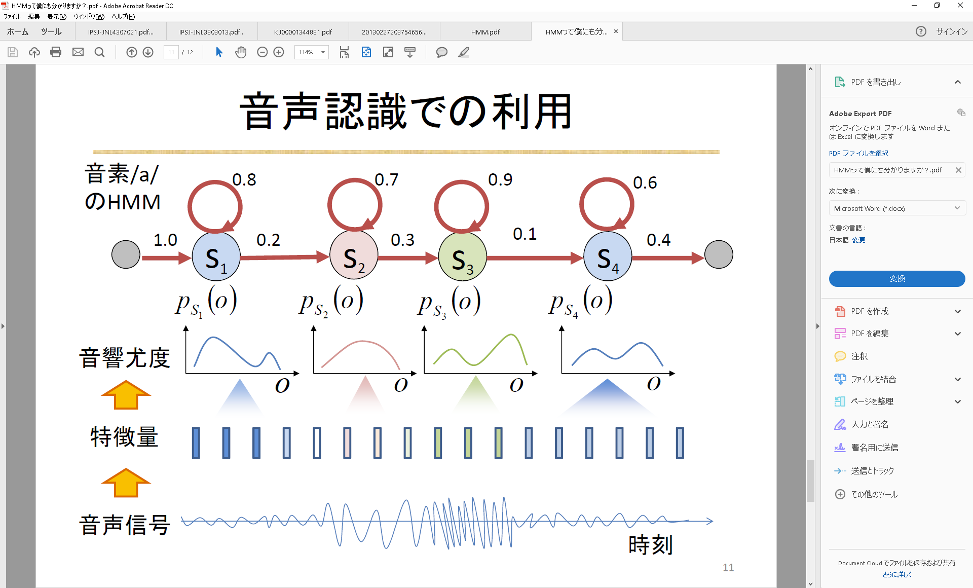
和音認識
講義では 離散型HMM
$$q_{1}$$
$$q_{n}$$
$$o_{1}$$
$$o_{m}$$
..
音響信号:連続
分散と平均を使って確率密度を正規分布化
連続型HMM
和音
特徴量
音響信号

